Slide 1
PNCC WATER DATA
A Dive Into the history and operation of the pncc water data system

Slide 2
Mark Bellhouse Senior dev @ pncc
intro
Notes:
Mark Bellhouse, Senior Dev/Solution Architect at PNCC
Worked here for almost 10 years, started off as a dev but moved into the big picture stuff so now I’m doing as much architecture and research as much as I am development.
The water data system ticks all the boxes for me – I’ve been able to cross over between investigation, system design and technical implementation, and have learned a lot about the city’s water infrastructure in the process.

Slide 3
What is the water data system?
Big picture

Slide 4
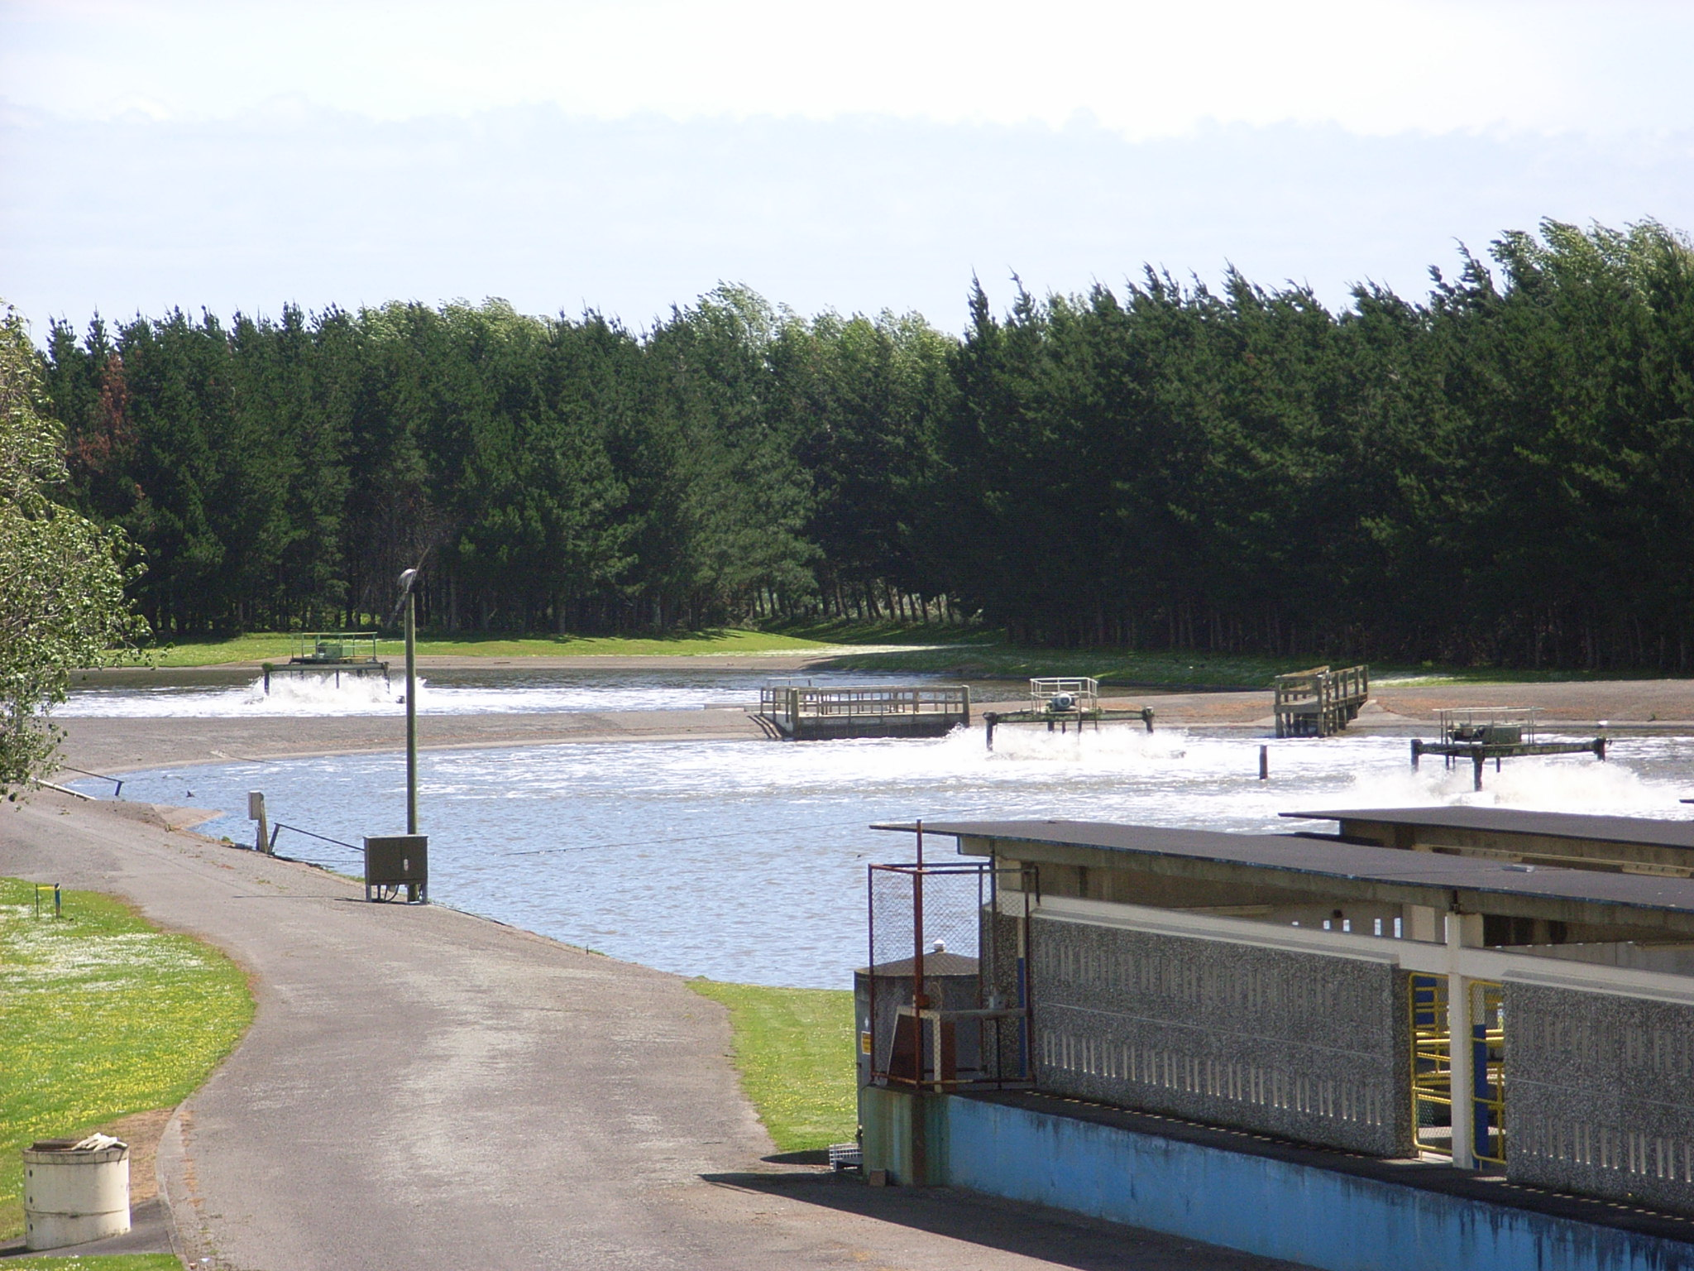
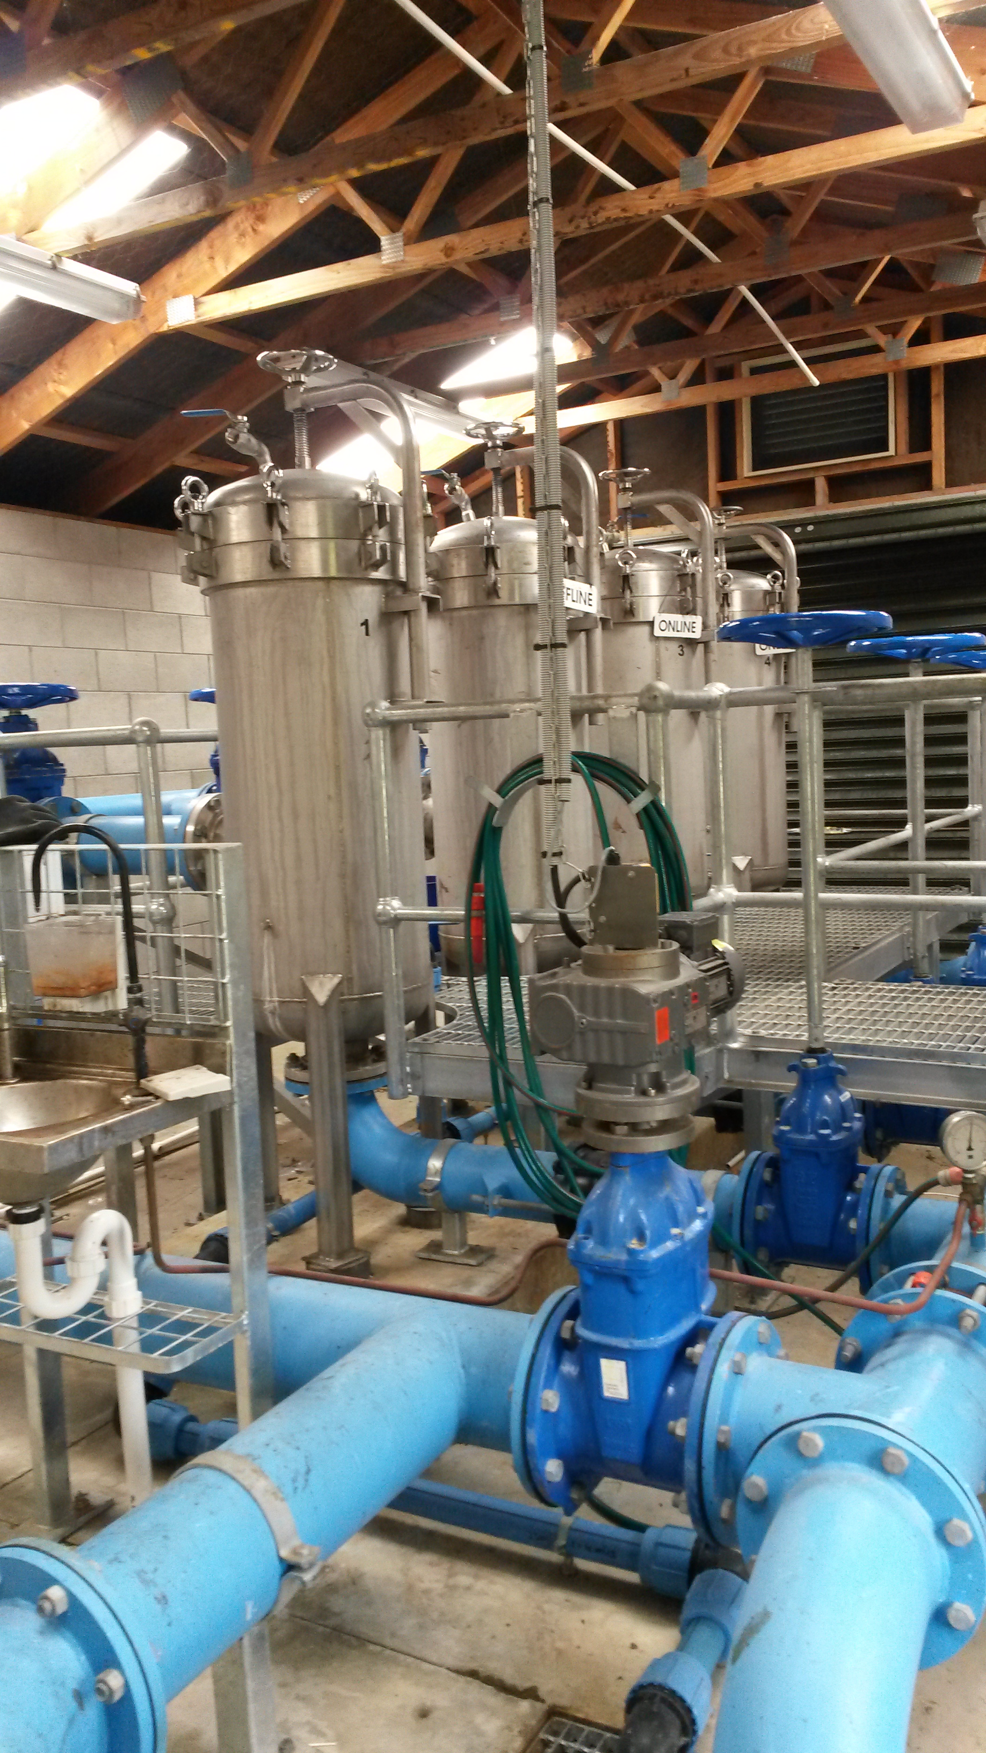
The water data system
Where does it come from?
Bores, pump stations, treatment plants
Equipment with attached data loggers
Measurements are mostly automated, with some manual
Notes:
We operate a number of bores, pump stations, treatment plants, and monitor water and waste as well as the natural environment around the city.
Much of the equipment involved either has inbuilt or attached data loggers, which allow the Infrastructure group within PNCC to operate the equipment safely and ensure the quality and compliance of our water and waste throughout the network.
Measurements are either taken automatically by SCADA or IoT-like devices, or by staff taking samples by hand, and the data is able to be sent to the Water Data System – which is a collection, storage and presentation system of what is effectively a timeseries dataset plus metadata, holding data in five-minute intervals back to 2008.

Slide 5
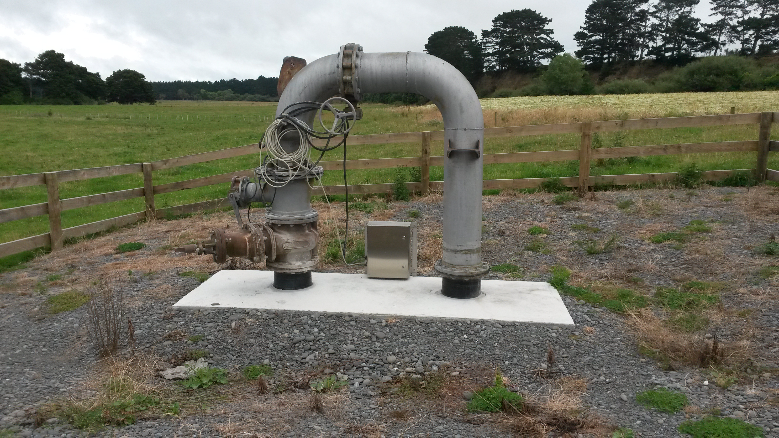
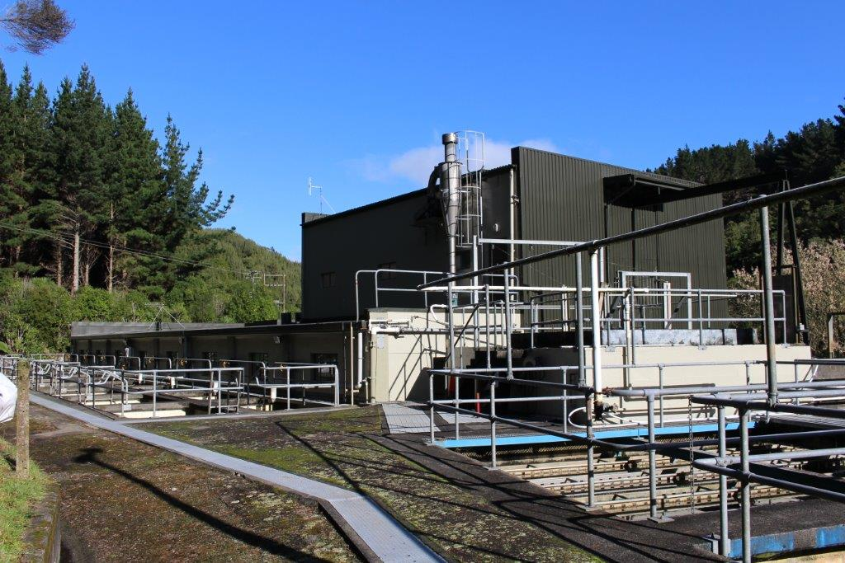
The water data system
Who uses the data?
Primarily used by our water team
Likely to be useful to other staff, BUT: either not available or hard to use!
Notes:
At the moment, the data is used by the (todo: what is the group called who operate the water/ww plant etc) within PNCC to confirm normal operation and what actions needs to be taken (todo: example from water treatment plant); secondly by the Three Waters team as part of compliance monitoring.
Along with internal use, we have partner organisations who take the data and add analytics and real-time analysis, and also we are required by law to provide proof of compliance to Horizons as part of our own resource consents.

Slide 6

The water data system
How could we use the data?
We used some of the data as evidence to help change the way PNCC enact water restrictions over summer in Palmerston North.
Historically, PNCC “played it safe”, but now making evidence-backed decisions.
We are able to be less restrictive on water use with voluntary restrictions:
pncc.govt.nz/services/water/summer-water-use
Notes:
One thing we are trying to do is to make it easier for staff to access and analyse the data, because we think it will be incredibly useful.
For example, historically there was a lot of guesswork around summer water restrictions, and we “played it safe” by enacting them early even though there may have been enough water to see us through.
But now we are making evidence-backed decisions and are able to be less restrictive on water use.
We’ve realised we want to use our data to make more of these kinds of decisions, and have designed the latest version to help make that possible.

Slide 7
Water data api
System architecture
Notes:
How it works
Decisions made
Evolution

Slide 8
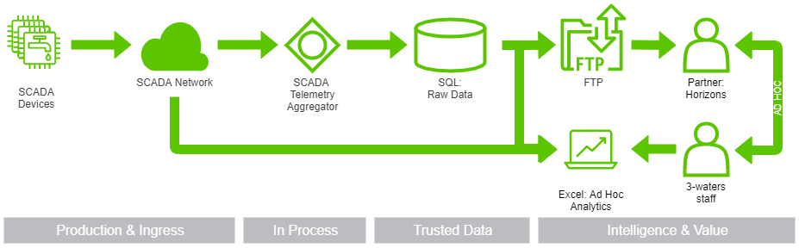
Version One 2008 – 2014 (or so)
Historic version
Simple data ingestion and ETL to Horizons.
Not all SCADA devices have data forwarded to SQL.
Technical staff perform analysis using the aggregator software, which has a very clunky, pre-windows UI, but can access all device data.
Notes:
Historic version
Simple data ingestion, extraction and delivery to Horizons via automated hourly and daily FTP csv file copy.
Not all SCADA devices have data forwarded to SQL.
Staff performing data analysis by generating graphs within and extracting data from the aggregator software. This had a very clunky, pre-windows UI, but does have access to all device data.

Slide 9
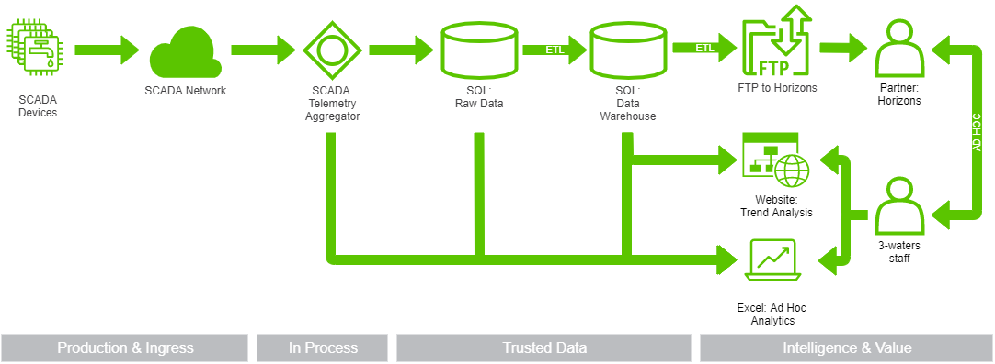
Version TWO 2014 - 2018
Driver for change: Offering staff a nice UI for repetitive analysis tasks.
Added a DW layer plus simple charting and data extraction UI for technical staff.
No real change to data transfer to Horizons.
Aggregator software still in use by technical staff for analysis and to access data not present in the DW.
Notes:
Driver for change: staff performing data analysis by generating graphs within and extracting data from the aggregator software, which has a very clunky, pre-windows UI, and we wanted to offer an easier way to perform common tasks.
Added a DW layer plus simple charting and data extraction UI for technical staff.
No real change to data transfer to Horizons.
Aggregator software still in use for more technical analyses and to access SCADA device data not present in the DW.

Slide 10
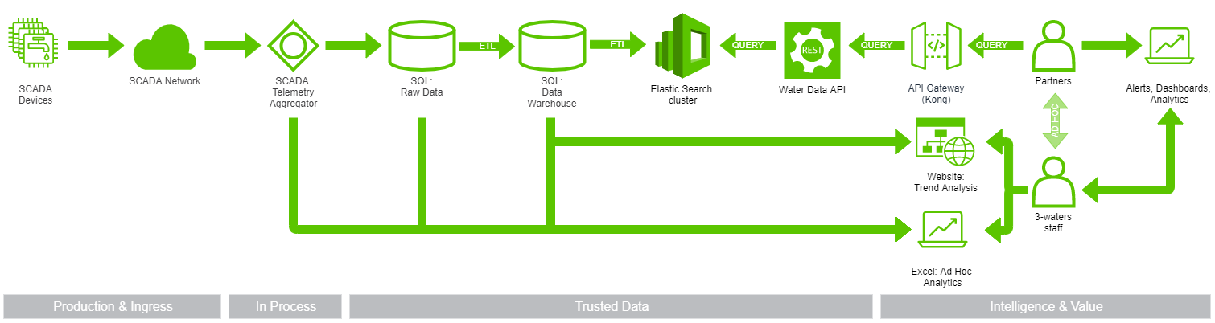
Version THREE 2018 - 2021
Drivers for change:
Retiring use of FTP
Support multiple partners
Support partner ad-hoc querying
Added Elastic Search store to improve api query performance over DW
Partners provide custom analytics
More SCADA data forwarded
Notes:
Two drivers for change:
no longer wanted to support FTP as a transfer mechanism,
needed to support multiple partners accessing the data
needed to support ad-hoc queries
Not all SCADA devices have data forwarded to SQL, but many more devices have data forwarded now,
DW + website still used for simple analytics.
ElasticSearch-backed, REST-based api added to website to allow multiple partners to query the same dataset – performs orders of magnitude better than SQL/DW-backed api.
Some partners provide value-add services based on our datasets, which staff consume as part of their role.

Slide 11
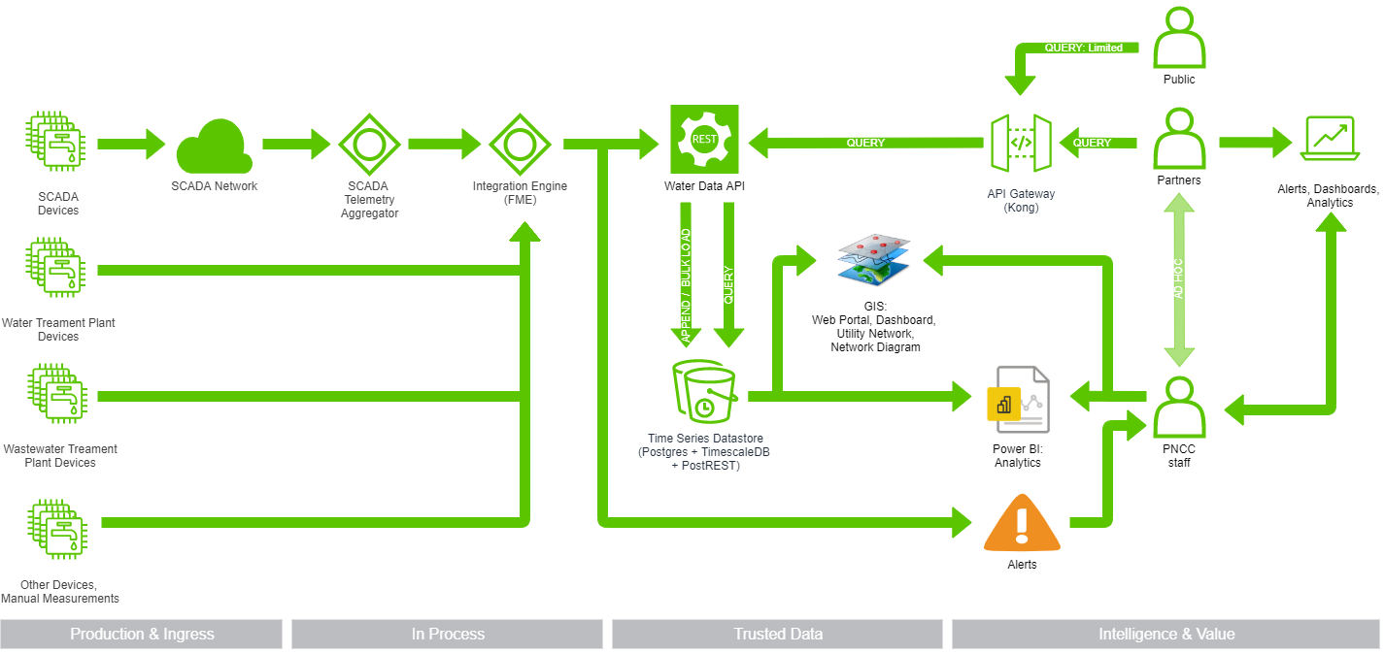
Version NEXT 2021+
Many drivers for change:
Elastic Search has missing data
Reduce number of copies of data
Introduce time-series datastore
Ingest more than just SCADA data
Share information and analytics across council staff
Changes:
Swap SQL + Elastic for Postgres + TimescaleDB + PostREST
Enhance API, allowing inserts
Add dataset to Power BI platform
Add dataset to GIS platform
Future-proof – cope with multiple sources
Notes:
Drivers for latest change:
- ElasticSearch datastore does not seem reliable and is not easy to verify (not well-architected)
- We are effectively storing multiple copies of a multi-GB dataset
- Partner integration is costly (for some things), and performs poorly. We want to bring some features back in-house.
- We want to allow storage of more than just SCADA data - Want to leverage the data, merge it with other datasets, and open it (and related analysis) to more users/uses in-house.
Add an integration engine to simplify ingestion from multiple sources. This also enables rules-based alerts.
Send all SCADA data, and IoT/sensor data from other water-related sources.
Swap out ElasticSearch for PostgreSQL + TimescaleDB + PostREST. This allows us to store timeseries data and present it via REST api. This replaces the SQL and Elastic datasets. And it performs better – in real-life tests, dropping from 120-180ms response times to under 90ms.
Add Append / Bulk Load feature to API.
Rate-limited public access to API (not advertised yet).
Add water dataset to our PowerBI analytics platform. Removes need for ad-hoc extractions and analytics.
Add water dataset to our GIS platform, merge with other datasets. eg. allowing staff to match logical plant layout with physical layout when on-site.

Slide 12
What does it look like?
Devices and measurements

Slide 13
PAPAOIEA PARK Bore
One resource consent we hold is ATH-2018201933.02, a Groundwater Take Water Permit. This is part of a combined consent that covers “Abstraction of Ground water from Bores for Palmerton North City Municipal Supply Purposes”.
The primary water supply for Palmerston North City is taken from the Turitea Stream, and is supplemented by the bores in this global Water Permit.
The consent limits the total combined daily abstraction from the three Pap Park bores to 17,980 cubic metres per day.
It also sets the maximum combined rate of abstraction from the three bores to 230 litres per second.
Each bore must have an accredited flow meter (including telemetry unit – see photo) capable of measuring the entire volume abstracted under authorisation of the consent.
The telemetry output is monitored by the Regional Council to ensure compliance with the resource consent.

Slide 14
resource consent compliance
scenario

Slide 15
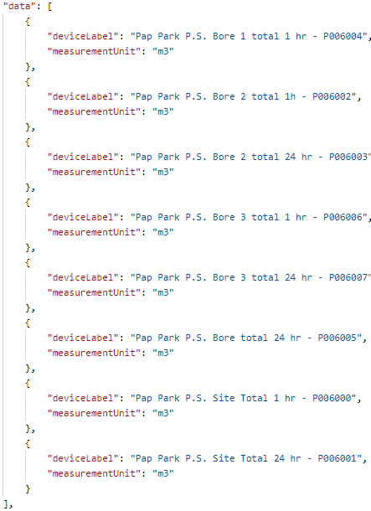
Are we taking too much water from pap park bores?
To prove compliance, we want to get the total m³ of water taken per day for all bores.
Read the docs! https://apidoc.pncc.govt.nz/doc/watertelemetry/
We can find devices based on partial name and measurement. Lets look for:
Device label like “pap”
Measurement unit = “m3”
/devices ?deviceLabel=*pap* &fields=deviceLabel,measurementUnit &measurementUnit=m3
Notes:
Read the docs!
We can search for the devices – these are the individual telemetry data sources.
Using PostMan, find matching devices:
deviceLabel like “pap”
measurementUnit = “m3”
Relevant matches:
Pap Park P.S. Bore 2 total 24 hr - P006003
Pap Park P.S. Bore 3 total 24 hr - P006007
Pap Park P.S. Site Total 24 hr – might be relevant, need to confirm by checking the data!
Note that bore 1 is not operational – it has a backup, and there is only enough power available to run two bores concurrently

Slide 16
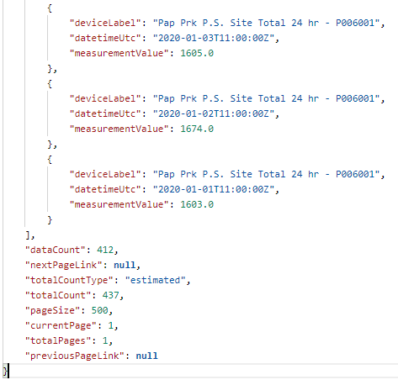
Are we taking too much water from pap park bores?
To prove compliance, we want to get the total m³ of water taken per day for all bores.
Read the docs! https://apidoc.pncc.govt.nz/doc/watertelemetry/
We can find measurements for devices based on SSID. Lets look for:
All records with SSID = P006001
Limit the fields returned
/measurements ?devicessid=P006001 &PageSize=500 &fields=deviceLabel,datetimeutc,MeasurementValue
Notes:
Here we have the full dataset for the Pap Park P.S. Site Total 24 hr measurement.
Note that the dataCount and totalCount don’t match up – this is due to using statistics to get a planned count of the query response rather than getting the exact count, which results in two queries (select + count), and therefore only performs well for small datasets.

Slide 17
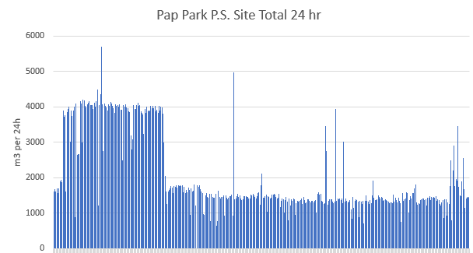
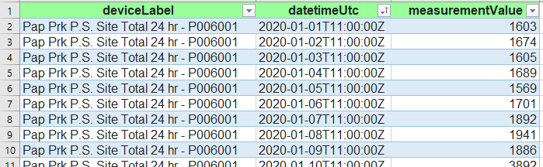
Are we taking too much water from pap park bores?
Lets look at the data…
Largest take was 5695m³
Smallest non-zero take was 645m³
Going further - two bins over 2020:
~3800m³ from mid Jan to mid April
~1300m³ until it jumps up around Jan 2021
To answer the question: No, we would need to take quite a lot more to hit our limit!
Notes:
Copy postman “data” value, paste into https://json-csv.com/, copy data into Excel.
To prove compliance, we want to get the data into excel and take a quick look.
Sorting by value, we can see the largest take was 5695m³, smallest non-zero was 645m³.
A simple graph shows there were roughly two bins over 2020:
~3800m³ from mid Jan to mid April
~1300m³ until it jumps up around Jan 2021.

Slide 18
Thanks for listening!
The End

